Slide 1

C.K.PITHAWALA COLLEGE OF ENGINEERING & TECHNOLOGY, SURAT
Branch:- Computer 4th Year/8th Sem
Group No:- 10
Subject:- Project-II (2180706)
Enrollment No. | Name | Guide
160090107007 | Kartik Fruitwala | Prof. Neelam A. Surti
160090107009 | Rahul Gandhi | Prof. Chetan K. Solanki
160090107016 | Utsav Haveliwala
160090107018 | Abhishek Jariwala
160090107029 | Yashesh Pandya

Slide 2
Face Recognition System for Boarding control at Airport
Project Topic

Slide 3
Topics to be covered:
Current Challenges and Motivation
Project Definition
Benefits
Aims and Objectives
Literature Review
System Modules
Project Specification
Implementation
Design
References

Slide 4
Current Challenges and Motivation
People often associate air travel with waiting.
Hours of standing in line to check in, get through safety and for boarding.
Traditional boarding control is much slower, unreliable.
Boarding pass can be faked.

Slide 5
Project Definition
passenger have to book their flight tickets.
The prerequisite of this system is that all the required biometric of the passengers will be available from passport office.
At the time of boarding, the passengers passes through the built-in camera, which clicks their photo and matches it with that of database photo which fetched from passport office.
If the person is legit then he is allowed to board, otherwise not.
The passenger may present their unique photo ID proof at the time of boarding.
Using biometric data, the process can be made smooth and simplified.

Slide 6
Benefits
Faster compared to Traditional boarding control.
Biometric data is much more reliable than its paper counterpart as it can’t be faked.
It accelerates boarding and improve security systems.

Slide 7
Aim & Objective
The Aim of our project is to make boarding easier and quicker for passengers flying on an aircraft.
This system is one of the biometric information processes. The System uses a combination of techniques in two stages: Face Detection and Recognition.
We will be having the sample image of the passengers boarding on the flight. Face Detection is applied on live acquired images. Face Recognition algorithms are applied in order to perform image processing. Based upon the processing, the passenger is checked for his/her legacy to board.
By using this we will be able to save the time of passenger.
As we know due to boarding process passengers have to wait so long so, we can reduce this waiting time by using this system because it is automatic process so, it well take lesser time than manual process.

Slide 8
Literature Review
Algorithm | Description | Advantage | Disadvantage
Eigen faces | Eigen Faces refers to an appearance-based approach to face recognition that seeks to capture the variation in a collection of face images and use this information to encode and compare images of individual faces in a holistic (as opposed to a parts-based or feature-based) manner. | Extract the relevant facial information, which may or may not be directly related to human intuition of face features such as the eyes, nose, and lips. One way to do so is to capture the statistical variation between face images. | Eigenface approach is not robust when dealing with extreme variations in pose as well as in expression and disguise

Slide 9
Literature Review (Cont..)
Algorithm | Description | Advantage | Disadvantage
Fisher faces | The most known DA is Linear Discriminant Analysis (LDA), which can be derived from an idea suggested by R.A. Fisher in 1936. When LDA is used to find the subspace representation of a set of face images, the resulting basis vectors defining that space are known as Fisher faces. | Same as in Eigen faces algorithm | Same as in Eigen faces algorithm.

Slide 10
Literature Review (Cont..)
Algorithm | Description | Advantage | Disadvantage
Local Binary Patterns | Local binary patterns (LBP) is a type of visual descriptor used for classification in computer vision. LBP is the particular case of the Texture Spectrum model proposed in 1990.LBP was first described in 1994. It has since been found to be a powerful feature for texture classification | • High discriminative power • Computational simplicity • Invariance to grayscale changes and • Good performance. | • Not invariant to rotations • The size of the features increases exponentially with the number of neighbours which leads to an increase of computational complexity in terms of time and space • The structural information captured by it is limited. Only pixel difference is used, magnitude information ignored.

Slide 11
Literature Review (Cont..)
Summary of OpenCV algorithms:
Eigen Faces (Holistic / Global Approach)
Codes and decodes image to gain recognition
Uses Principal Component Analysis (PCA)
Fisher Faces (Feature based / Local Approach)
Better handles interpersonal images such as lighting
Uses Linear Discriminant Analysis (LDA)
Local binary pattern histograms
Comparison of each pixel to its neighbours

Slide 12
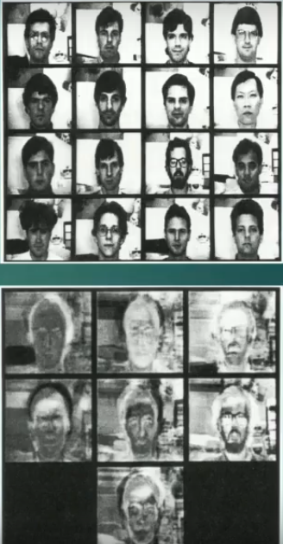
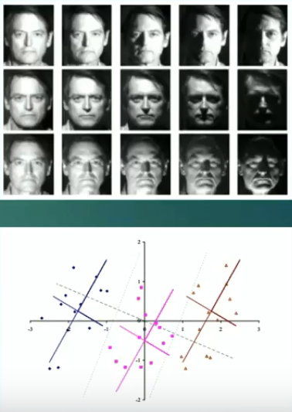
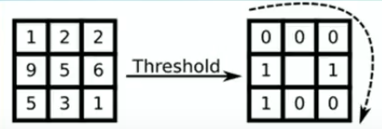
Literature Review (Cont..)

Slide 13
Literature Review (Cont..)
The following review is based on the hardware used for face recognition.
No. | Hardware | Description
1. | Camera Module | In earlier applications camera of 4.0 mega-pixels was used. It is dependent on us to put greater pixels of camera.
2. | Dot Projector | Well, Face ID first makes a 3D image, and for that, the dot projector throws 30000dots on the face of the user within milliseconds. These 30000 dots of light create and builds a map of your face and then the infrared camera reads the dot structure on your face.

Slide 14
System Modules
Modules
Ticket Module: The ticket module is used to book flight ticket for particular airlines.
Face Detection Module(Software Module): This Module will use face detection algorithms to take samples of the passengers' face and calculate the face features.
Face Recognition & Image Processing Module(Software Module): This module will be a feature for identifying faces according to the changes in the person’s face.
Generate Boarding pass Module: This module will fetch data from database according to passport id and generate boarding pass.

Slide 15
Project Specifications (Tools and Technologies)
Hardware:
Camera
Dot projection
Software:
PIL(Python Imaging Library): Provides support for opening, manipulating, and saving many different image file formats.
OpenCV: Searches faces from a picture.
Face_recognition module: Provides various steps for face recognition using grey scale.
PyCharm: Python IDE
Pillow: Provide support for image operation.

Slide 16
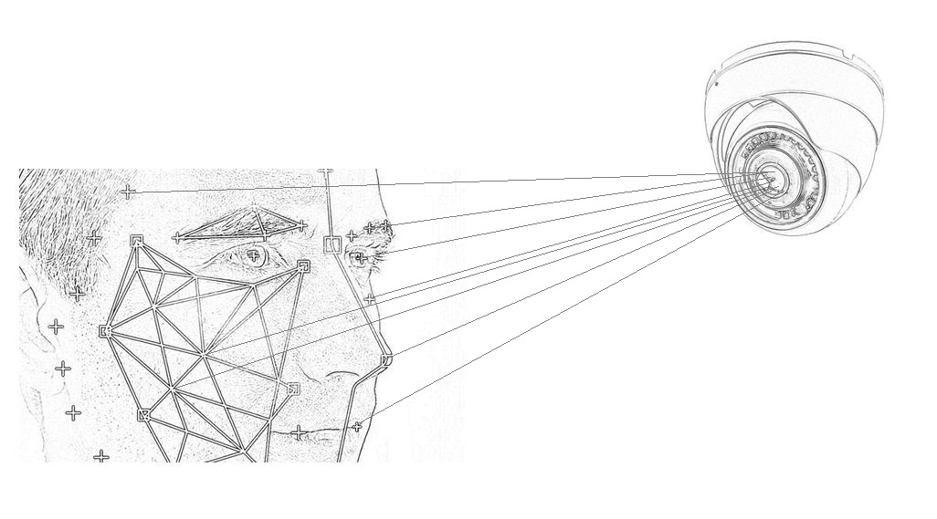
Pictorial Representation

Slide 17
Implementation (Web Development)

Slide 18
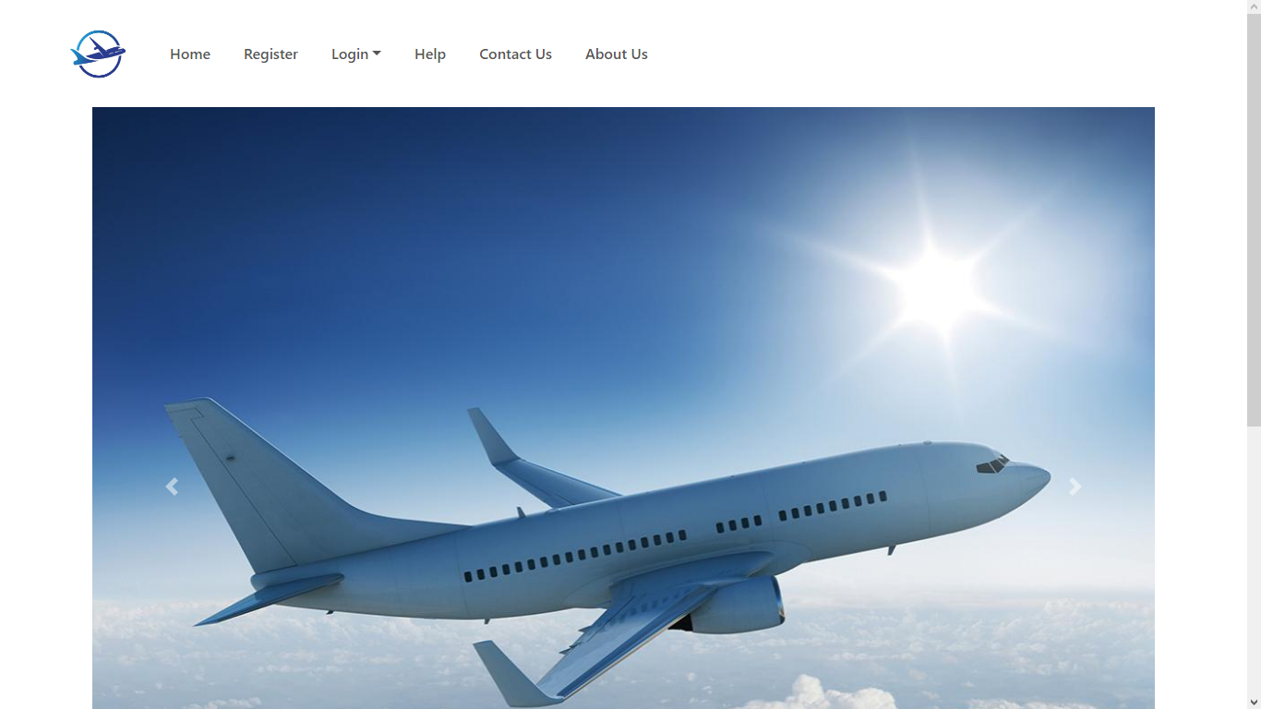
Interface 1: Home Page

Slide 19
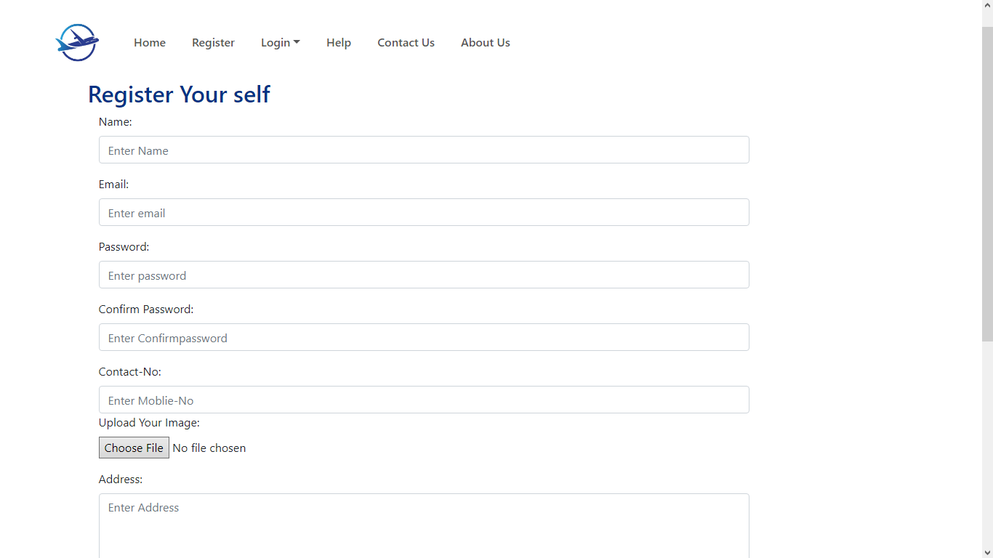
Interface 2: Passenger Registration Page

Slide 20
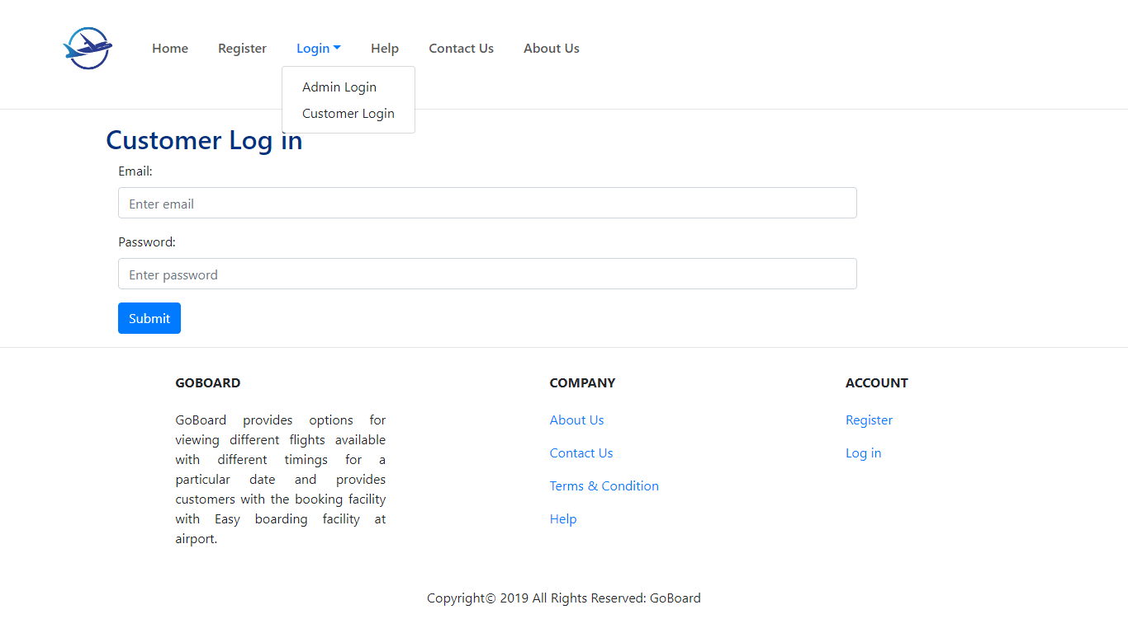
Interface 3: Login Page

Slide 21
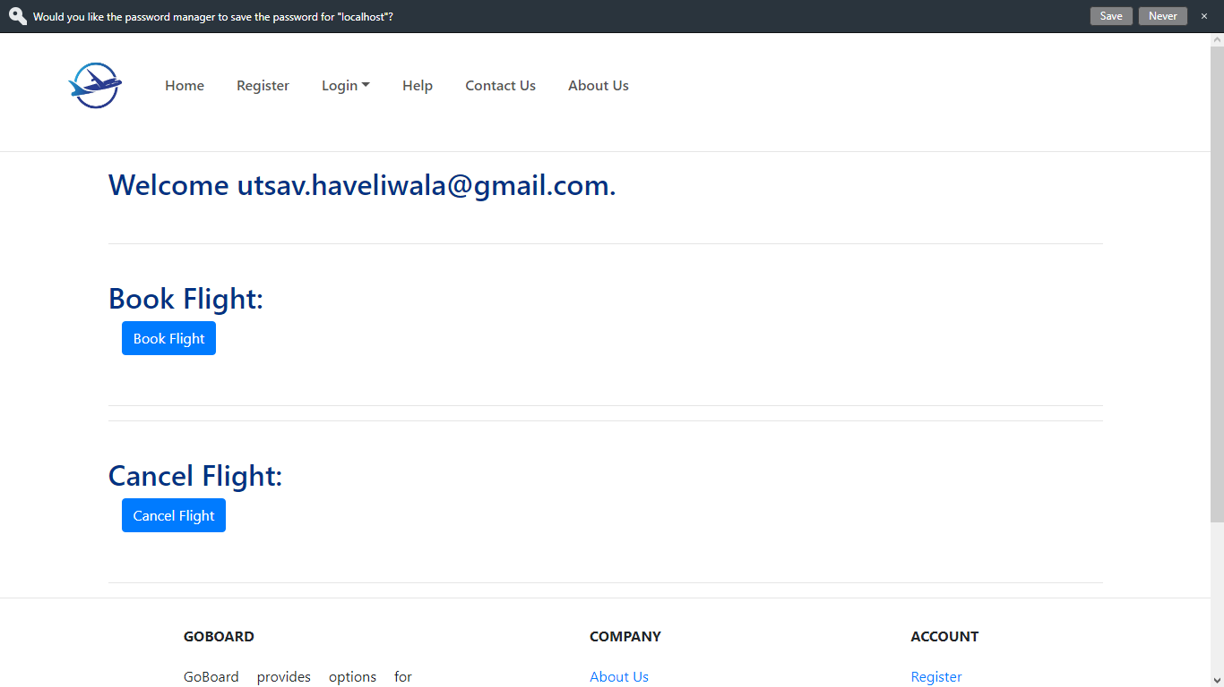
Interface 4: Passenger Account Page

Slide 22
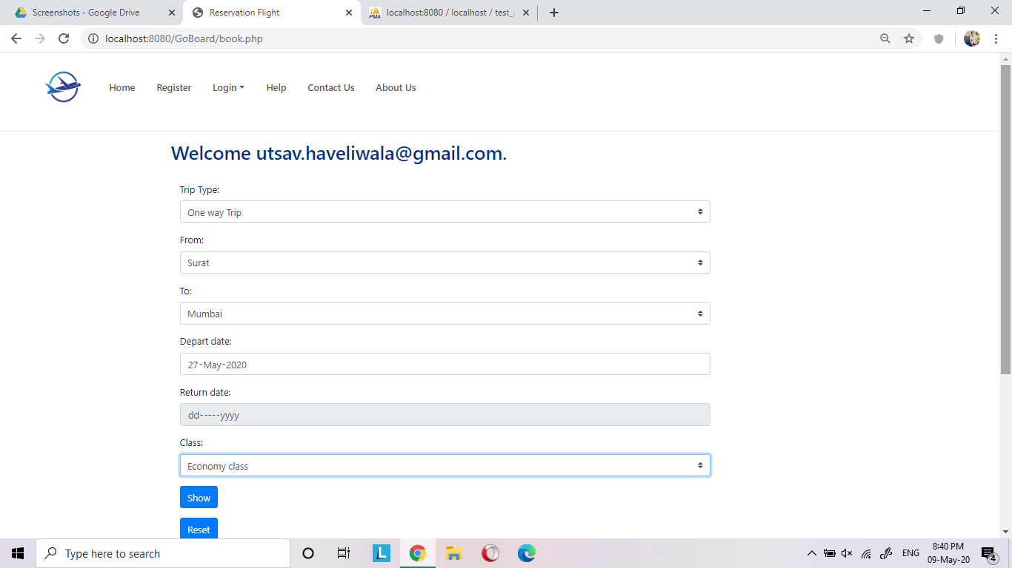
Interface 5: Flight Ticket Booking Page

Slide 23
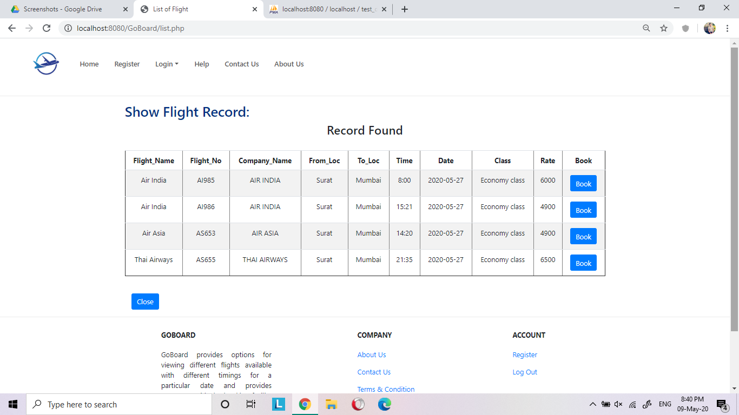
Interface 6: Flight Information Page

Slide 24
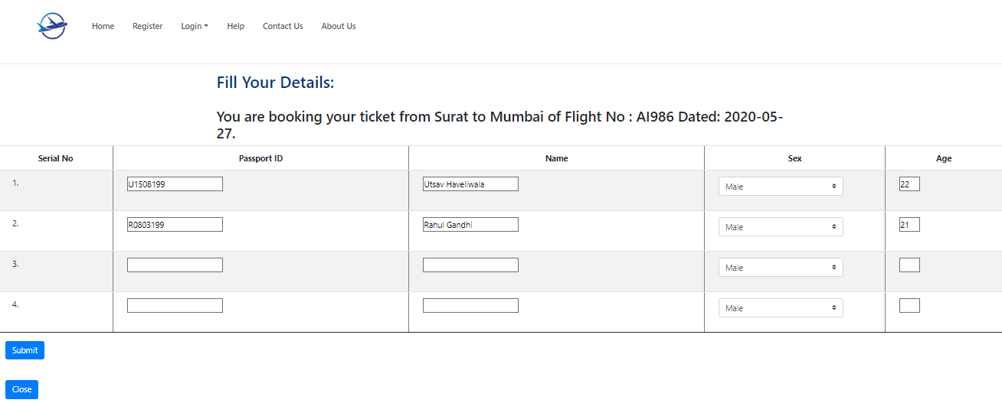
Interface 7: Ticket Reservation Page

Slide 25
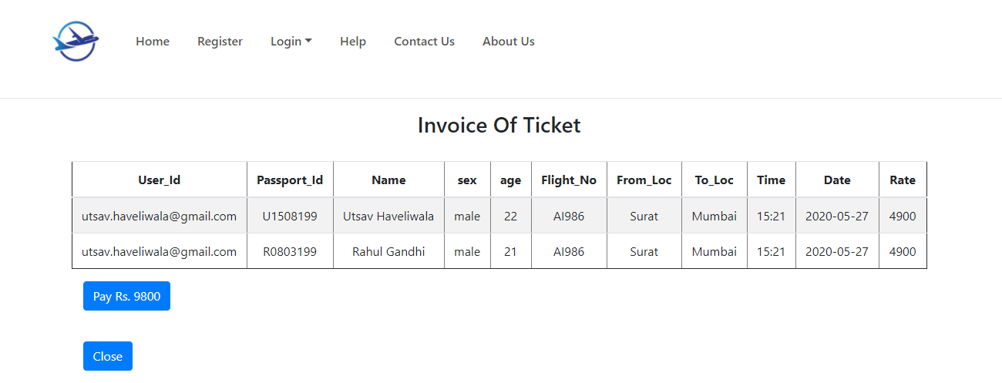
Interface 8: Ticket Confirmation Page

Slide 26
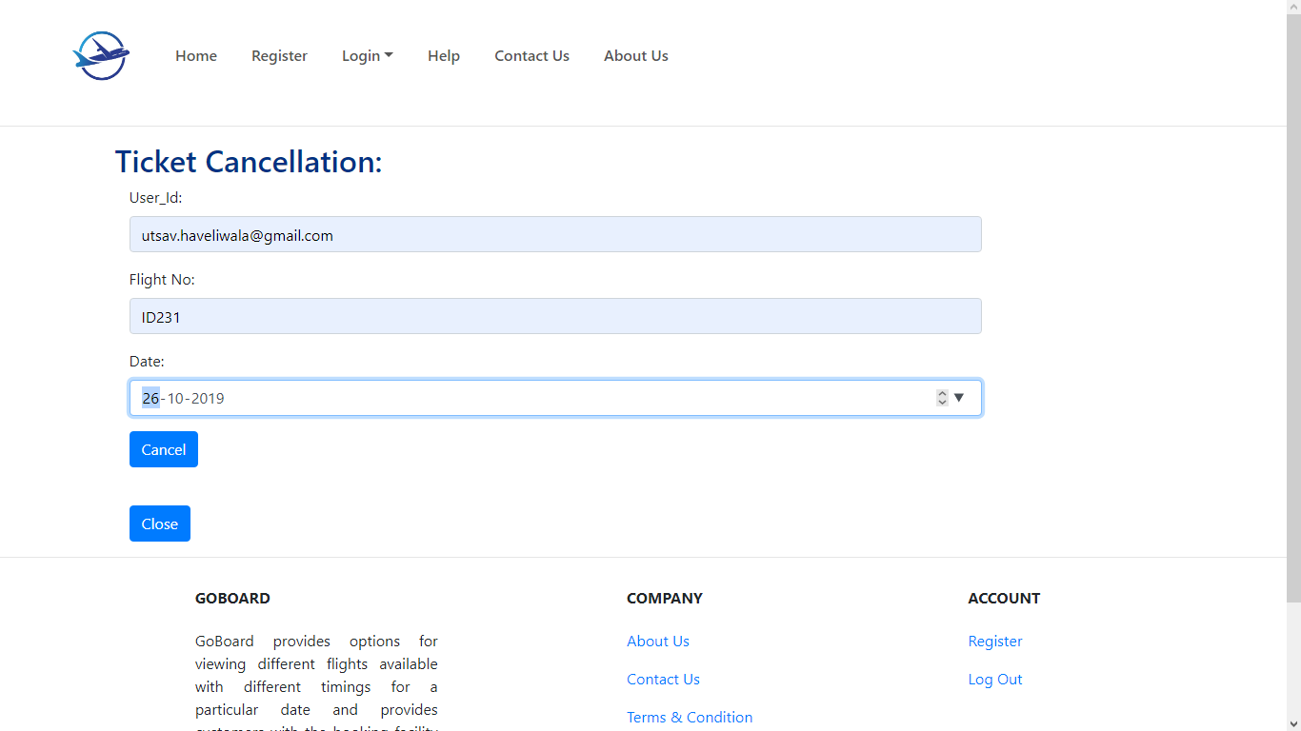
Interface 9: Ticket Cancellation Page

Slide 27
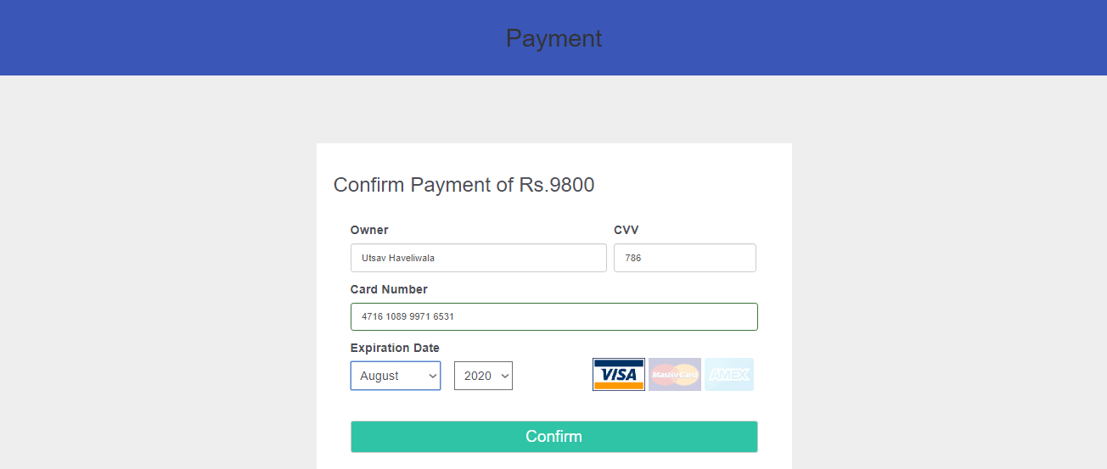
Interface 9: Payment Page

Slide 28
Implementation (Database Design)

Slide 29
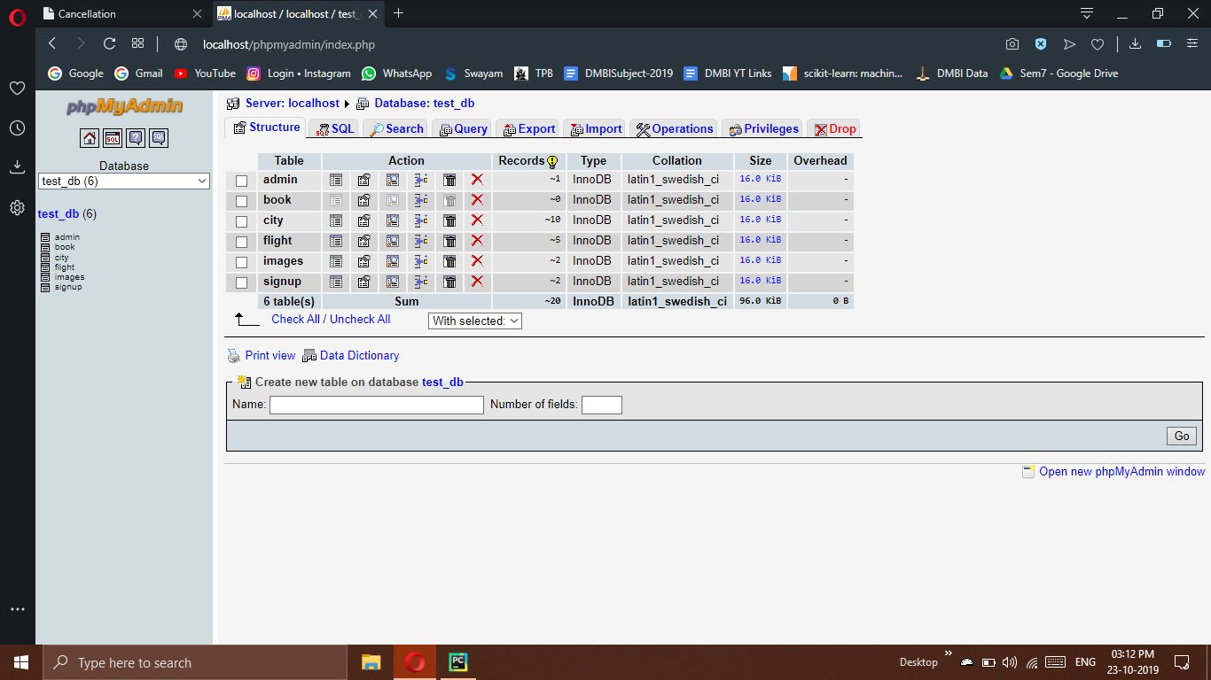
Table 1: Database

Slide 30
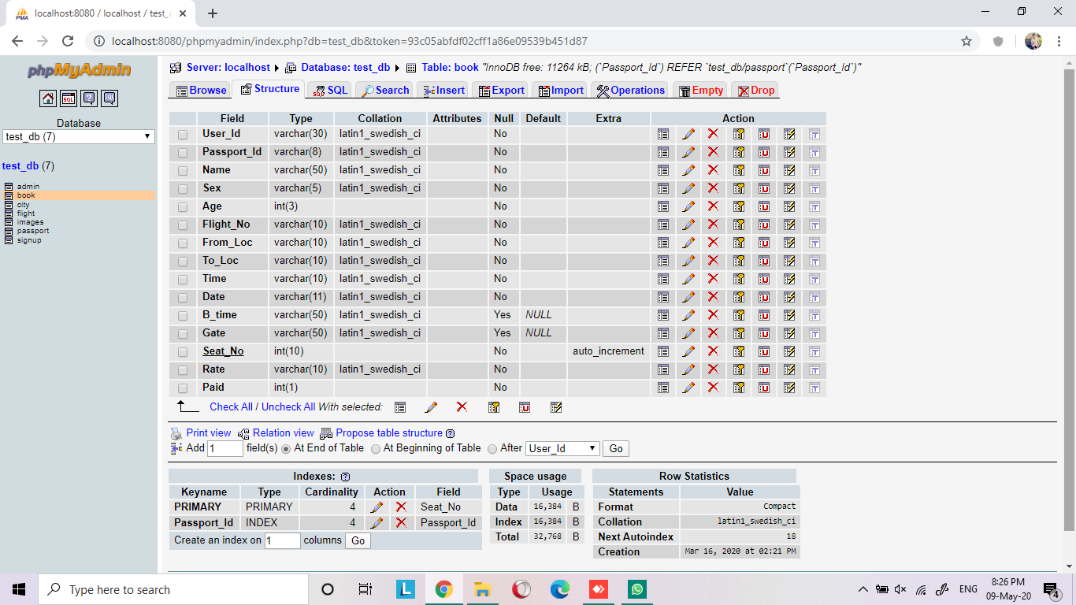
Table 2: Booking Table

Slide 31
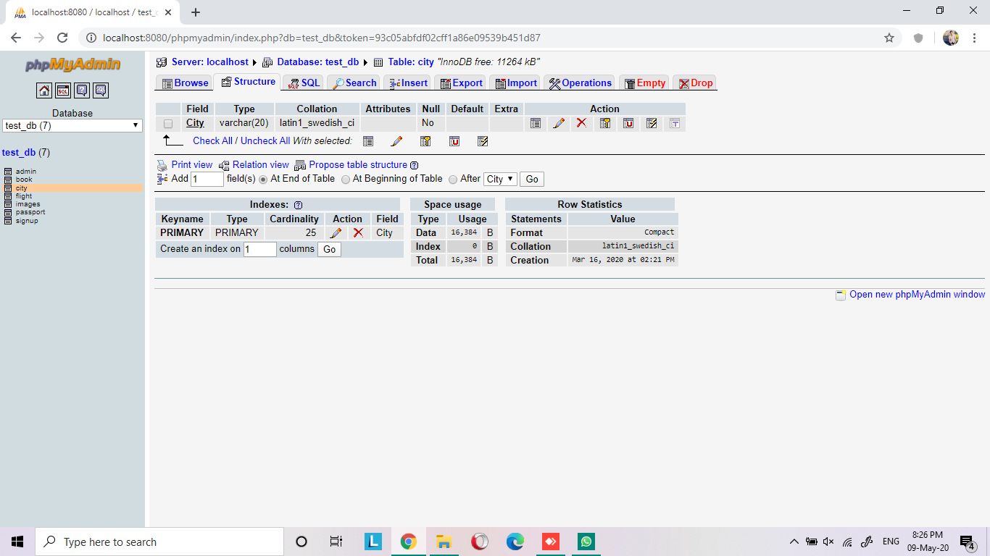
Table 3: City Table

Slide 32
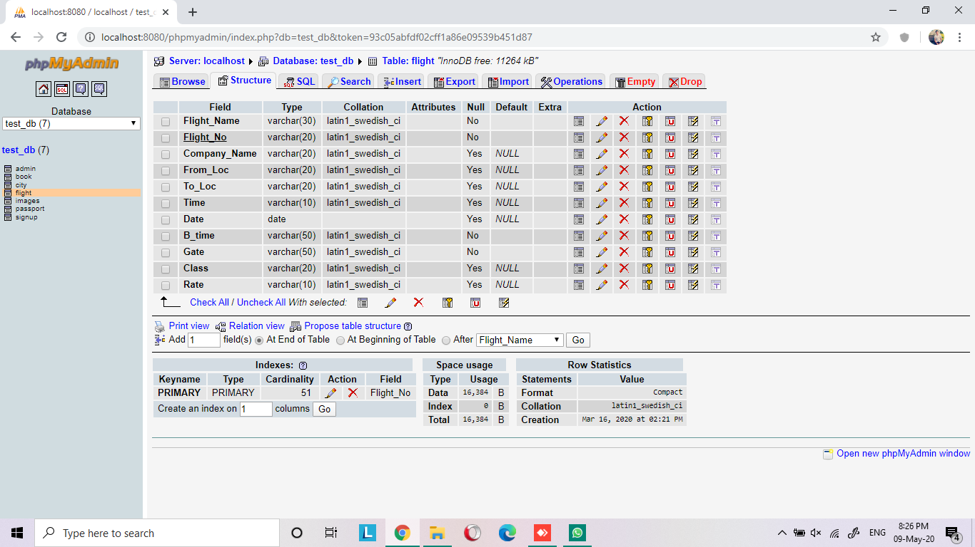
Table 4: Flight Table

Slide 33
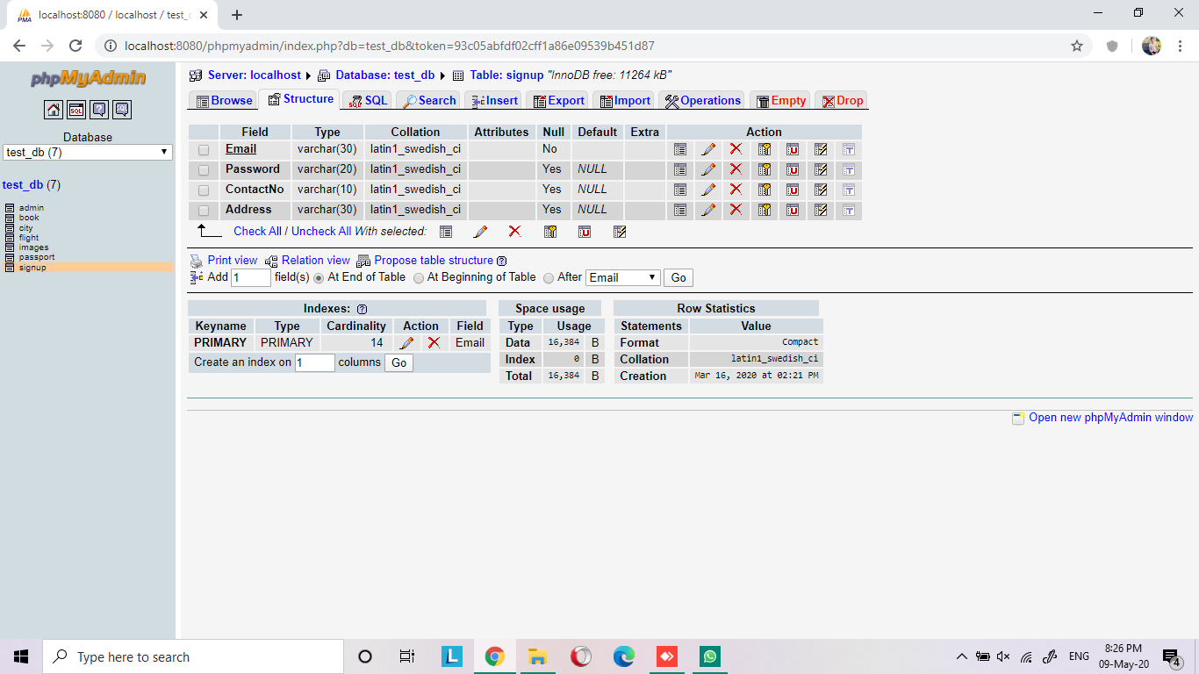
Table 6: Passengers Table

Slide 34
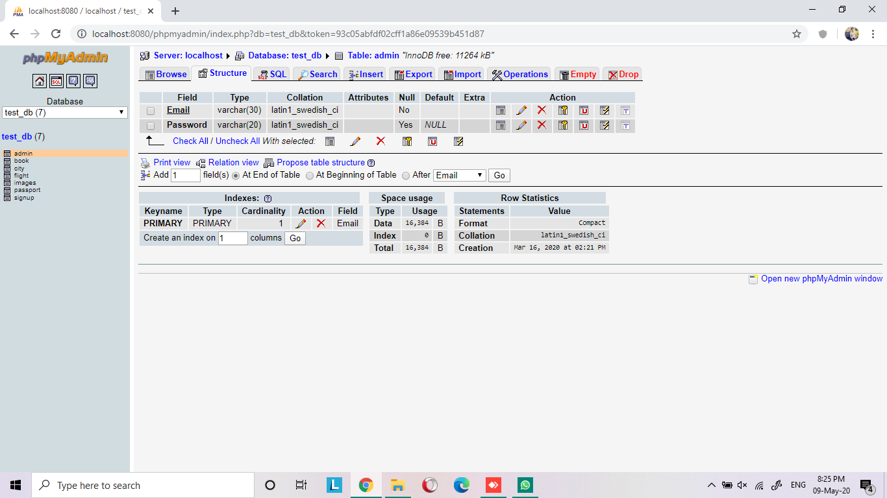
Table 7: Admin Table

Slide 35
Implementation (Face Recognition Algorithm)

Slide 36
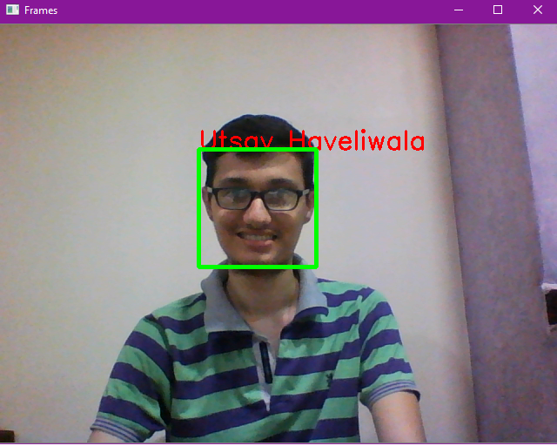
Recognizing Face

Slide 37
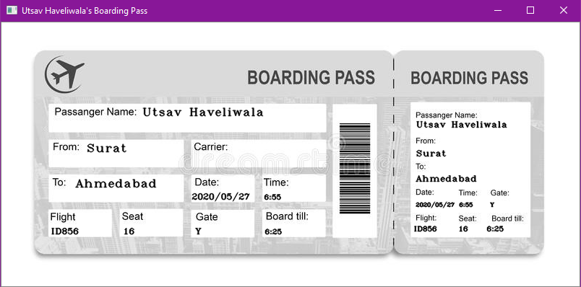
Boarding Pass

Slide 38
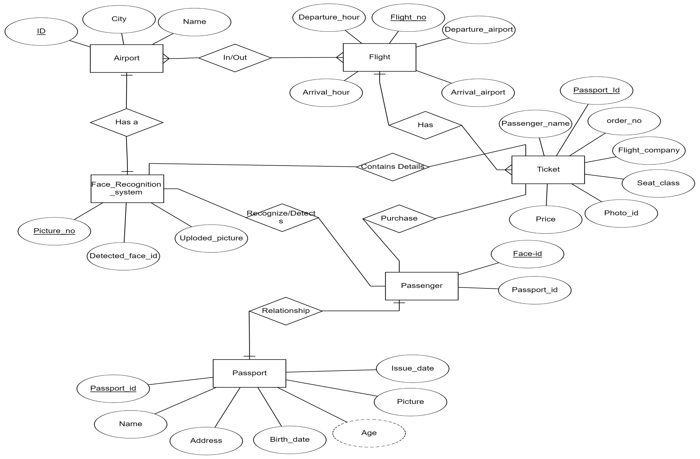
ER-Diagram

Slide 39
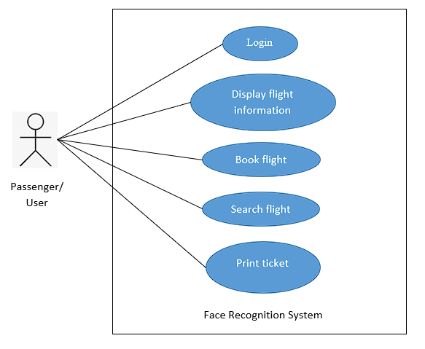
Use-case Diagram
Use – case diagram of Passenger/User

Slide 40
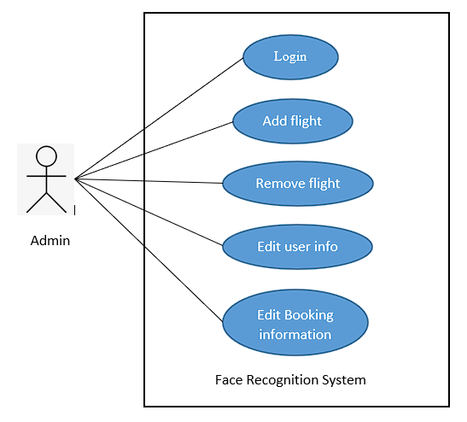
Use-case Diagram
Use-case diagram of Admin

Slide 41
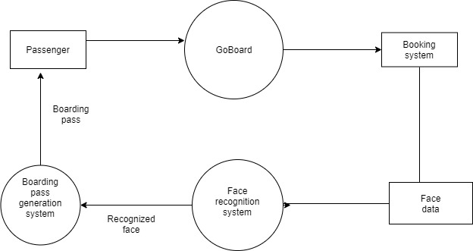
DFD

Slide 42
Conclusion And Future Scope
To conclude, in many countries passengers are facing the problem of standing for long time in queue and waiting for too long. The waiting time can be curtailed by the given system. The passengers do not have to wait long as compared to traditional system. The security flaws can be overcome by this system.
As machine learning is a tremendously trending now a days. Many organizations are enforcing face recognition system for their system. The face recognition system can be equipped with any organization to for the lap of clover.
Even many airports have introduced this system since 2014 and many are going to introduce the same.

Slide 43
References
No | References
1. | https://www.researchgate.net/publication/228790347_A_Summary_of_literature_review_Face_Recognition
2. | https://www.researchgate.net/publication/233864740_Face_Recognition_A_Literature_Review
3. | http://ijcttjournal.org/Volume5/number-4/IJCTT-V5N4P136.pdf

Slide 44
Thank You

